Slide 1
Chapter 37 & 38: The wave nature of light
Reading assignment: partial chapter 37; specifically, double slit diffraction
Homework 37: (not due): 4, 7
In the previous two chapters we were treating light as rays. A powerful, simple method.
Now we are treating light as a wave → wave optics
Diffraction patterns
Double slit
Single slit
Diffraction grading
Thin film interference
Polarization

Slide 2
Announcements
Final exam is scheduled for
Friday, May 10, 9:00 am – 12:00 pm, Olin 101 (class room).
Early date: Tuesday, May 7, 9:00 am – 12:00 pm, Olin 101 (class room).
Final exam will be comprehensive:
Chapters 23 – 29, partial 34 (EM waves, c, E, B perpendicular), 35, (partial) 36, not 37 &38 (diffraction)
Review on Thursday, May 9, 5:00 pm – 7:00 pm, Olin 101 (class room)
I’ll send out equation sheet
Webpage will be updated (all ppt slides, all scores, etc)
Thanks for being a wonderful class!!
Best of luck to all of you!!

Slide 3
Huygens’s principle: Wavelets
Every point on a wave front can be considered as a source of tiny wavelets that spread out in the forward direction at the speed of the wave itself. The new wave front is the envelop of all the wavelets – that is the tangent of them.

Slide 4
Diffraction
From Huygens’ principle:
When waves impinge on an obstacle, the waves bend in behind the obstacle.
This divergence of light from its initial line of travel (e.g. bending of waves behind an obstacle into the ‘shadow region’) is called diffraction.
Note that the ray model cannot account for diffraction. The ray model works only when objects that are larger than the wavelength of light (d >> λ).
Now we are in a regime where d ~ λ or d << λ
The wavelength of visible light is about 400 nm – 800 nm.

Slide 5
Wave Interference,
Constructive and Destructive interference
White board

Slide 6
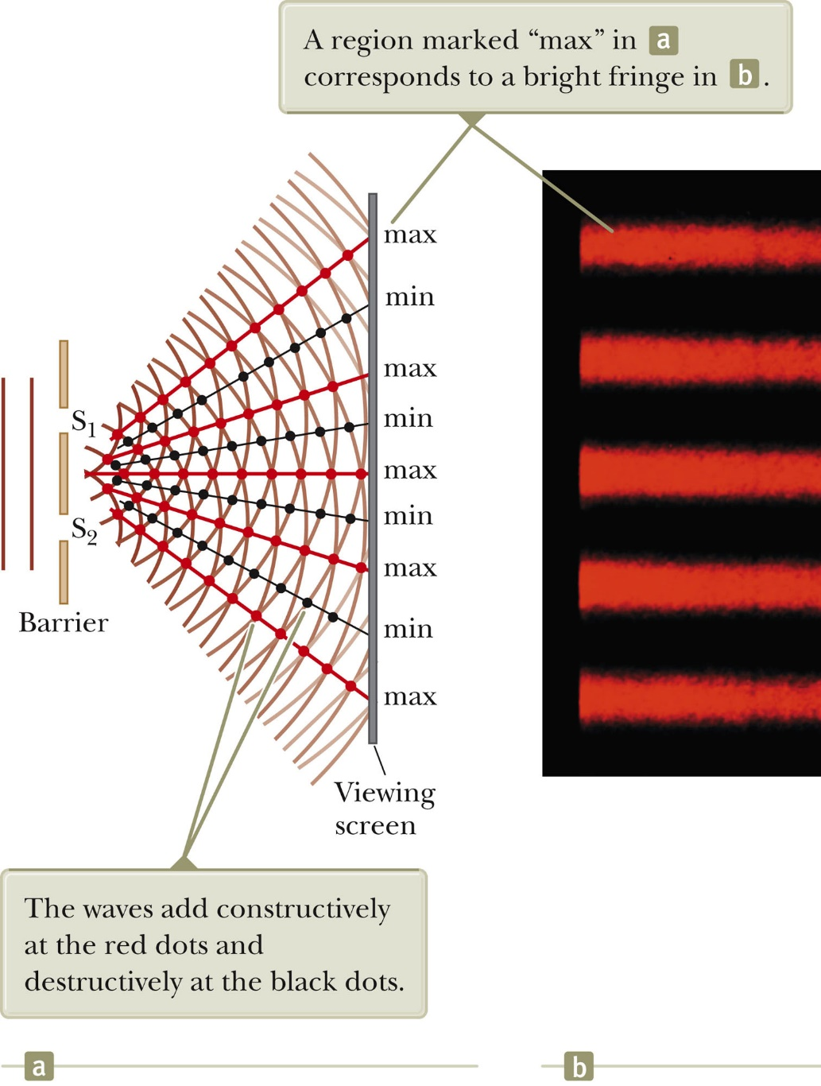
Interference – Young’s double-slit experiment, (1801)
Evidence for the wave nature of light.
Light from a single source falls on a screen containing two closely spaces slits.
We observe a series of bright lines (dots) due to constructive and destructive interference of light waves.
If light would be treated as rays or particles we would only expect two bright lines (dots).

Slide 8
Interference – Young’s double-slit experiment, (1801)
Evidence for the wave nature of light.
Light from a single source falls on a screen containing two closely spaces slits.
We observe a series of bright lines (dots) due to constructive and destructive interference of light waves.
If light would consists of particles we would only expect two bright lines (dots)

Slide 9
Interference – Young’s double-slit experiment
Constructive interference: The crests of one wave arrives at the same time as the crests of an other wave. The path difference of waves is a full wavelength.
Destructive interference: The crests of one wave arrives at the same time as the troughs of another wave. The paths of the waves differ by half a wavelength.
The path difference between waves pd = d·sinθ

Slide 10
Interference – Young’s double-slit experiment
Constructive interference: When the path difference d·sinθ between waves is a whole number of wavelength:
d·sinθ = mλ, m = 0, 1, 2, 3, … Maxima
Destructive interference: When the path difference d·sinθ between waves is a 1/2, 2/3, and so on, wavelengths:
d·sinθ = (m + ½)λ, m = 0, 1, 2, 3, … Minima

Slide 11
White board example, class room demo
A Young's interference experiment is performed with blue-green laser light. The separation between the slits is 0.500 mm, and the screen is located 3.32 m from the slits. The first bright fringe is located 3.32 mm from the center of the interference pattern.
What is the wavelength of the laser light?
For double slit:
d·sinθ = mλ, m = 0, 1, 2, 3, … Maxima
d·sinθ = (m + ½)λ, m = 0, 1, 2, 3, … Minima

Slide 12
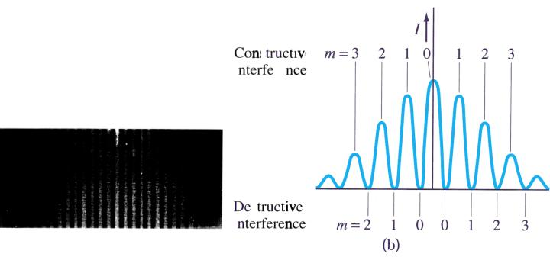
White board example
Light of wavelength 696 nm falls on a double slit, and the first bright fringe of the interference pattern is seen at an angle of 15.2° with the horizontal.
Find the separation between the slits.
Constructive interference
Destructive interference

Slide 13
Two iclickers
Line spacing for double slit interference.
A screen containing two slits 0.1 mm apart is 1.2 m from the viewing screen. Light of wavelength λ = 500 nm falls on the slits from a distant source.
iclicker 1:
What happens to the interference pattern above if the incident light (500 nm) is replaced by light with a wavelength of 700 nm?
The angle θ gets larger C) The pattern disappears
The angle θ gets smaller D) We get 7 instead of 5 maxima
iclicker 2:
What happens instead if the slits are moved further apart.
The angle θ gets larger C) The pattern disappears
The angle θ gets smaller D) We get 7 instead of 5 maxima
d·sinθ = mλ, m = 0, 1, 2, 3, … Maxima
d·sinθ = (m + ½)λ, m = 0, 1, 2, 3, … Minima

Slide 14
Diffraction by a single slit
Destructive interference: When top half of light and bottom half of light cancel each other out as in (b) below.
Thus, destructive interference when the path difference D·sinθ = λ.
Also destructive interference when path difference D·sinθ = 2λ as in (d) below.
Thus,
D·sinθ = mλ, m = 0, 1, 2, 3, … Minima
D·sinθ = (m + ½)λ, m = 0, 1, 2, 3, … Maxima

Slide 15
Diffraction by a single slit
Thus,
D·sinθ = mλ, m = 0, 1, 2, 3, … Minima
D·sinθ = (m + ½)λ, m = 0, 1, 2, 3, … Maxima
* The formulas for maxima and minima are “reversed” as compared to the double slit and grating.

Slide 16
Black board example (example 24-4)
Single slit diffraction maximum.
Light at wavelength 750 nm passes through a slit 1.0x10⁻⁵ m wide. How wide is the central maximum (a) in degrees and (b) in centimeters on a screen 20 cm away?

Slide 17
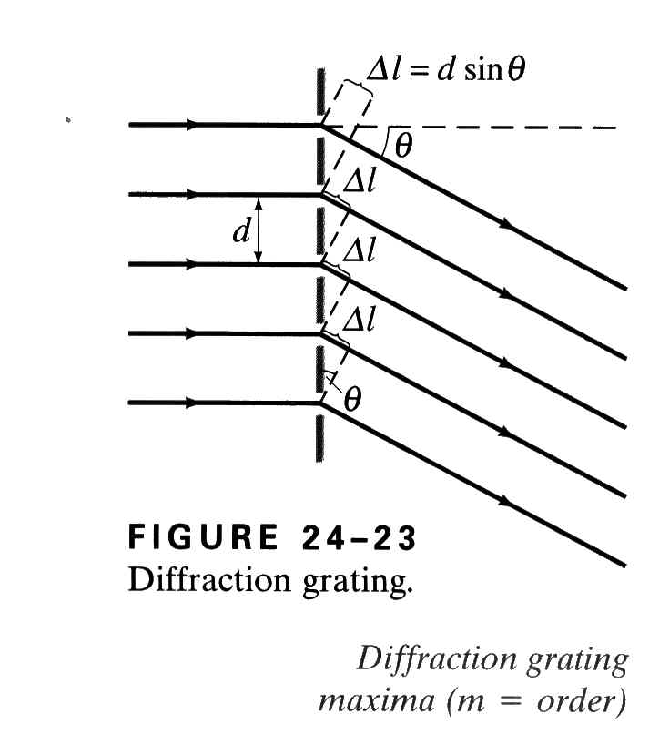
Diffraction grating
A large number of equally spaced parallel slits is called a diffraction grating.
The minima and maxima are obtained like in the double-slit experiment
The maxima are much sharper for a diffraction grating.
Maxima at:
d·sinθ = mλ, m = 0, 1, 2, 3, …

Slide 18
Black board example (example 24-6)
Diffraction grating: lines.
Calculate the first- and second-order angles for light of wavelength 400 nm and 700 nm if the grating contains 10,000 lines/cm.
Maxima at:
d·sinθ = mλ, m = 0, 1, 2, 3, …

Slide 19
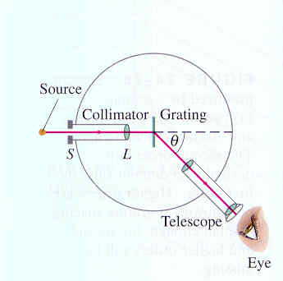
Spectrometer and spectroscopy
A device to measure wavelengths accurately using a diffraction grating or a prism
Use: identification of atoms or molecules. When a gas is heated it emits a characteristic line spectrum (as opposed to the continuous spectrum coming from the sun
Biochemistry: DNA and proteins adsorb light at a particular wavelength (DNA, λ = 260 nm; protein, λ = 280 nm). The amount of absorption, as compared to a standard solution reveals presence and concentration of a particular type of molecule.

Slide 20
Interference by thin films
Light rays are reflected at top and at bottom surface.
Caution: If reflection occurs at an optically denser medium, an additional ½ λ phase change occurs.
Constructive interference:
If the path traveled by the second ray is longer by an integer amount of wavelengths.

Slide 21
Black board example (example 24-9)
Thickness of a soap bubble.
A soap bubble appears green (λ = 540 nm at the point on its front surface nearest the viewer. What is the minimum thickness? Assume n = 1.35
Air
Soap
Air

Slide 22
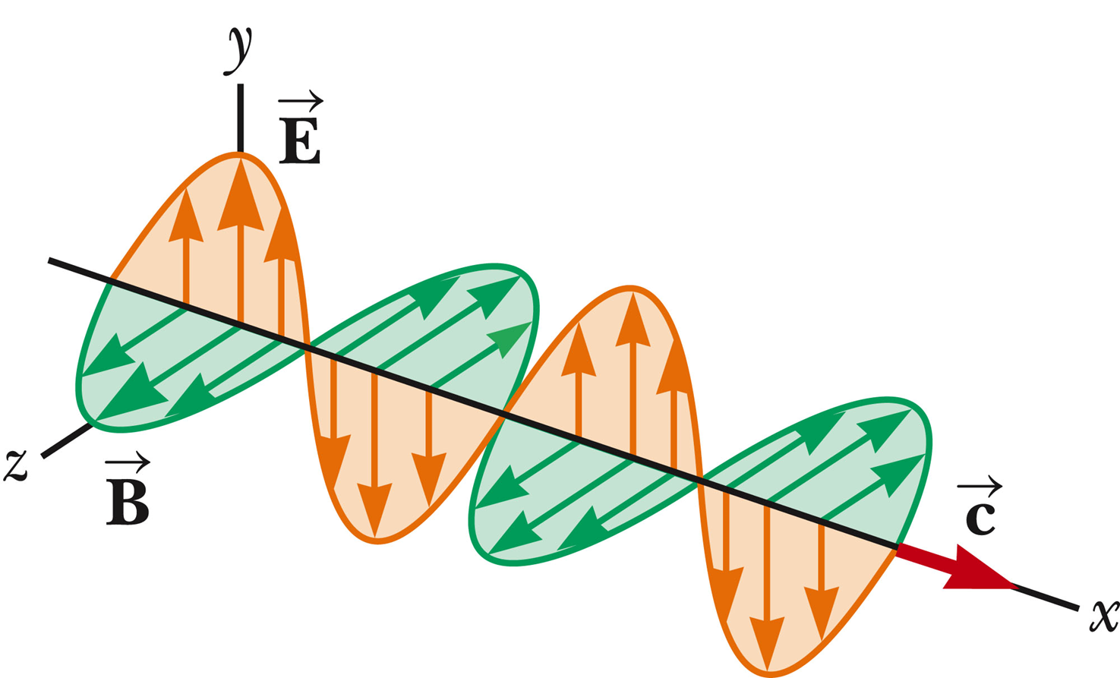
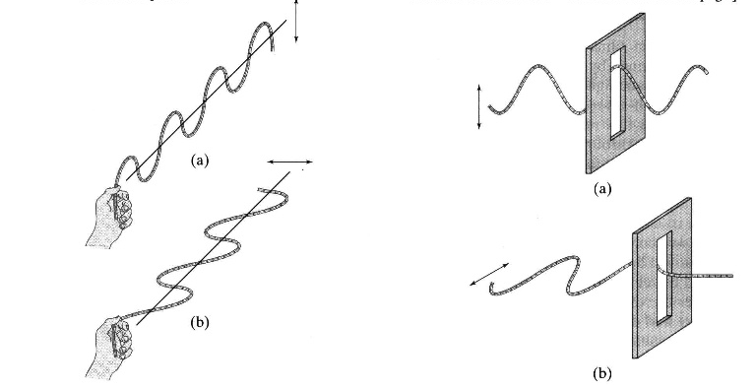
Polarization of light (show movie: https://www.youtube.com/watch?v=4CtnUETLIFs)
Light is a transverse electromagnetic wave in which the E-field, B-field and progagation direction are all perpendicular to each other
Light sources emit a large number of waves having some particular orientation of the E-field vector
Unpolarized light: E-field vectors all point in a random direction
Polarized light: E-field vectors all point in the same direction. = direction of polarization
Light wave:
Mechanical analog;

Slide 23
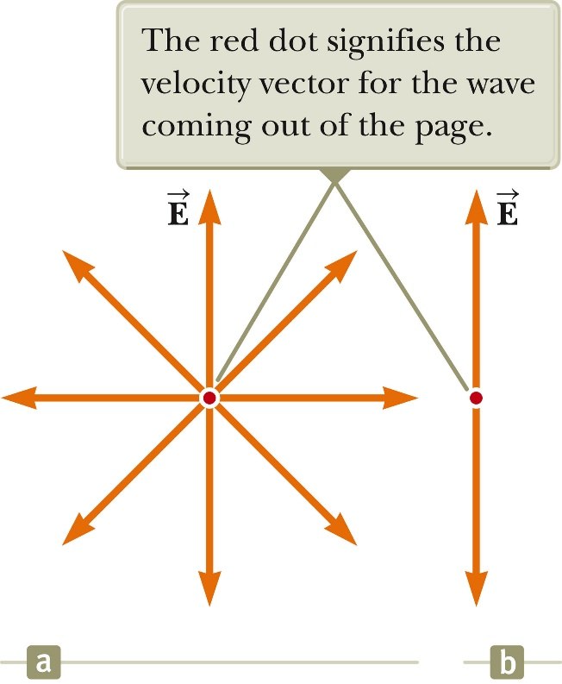
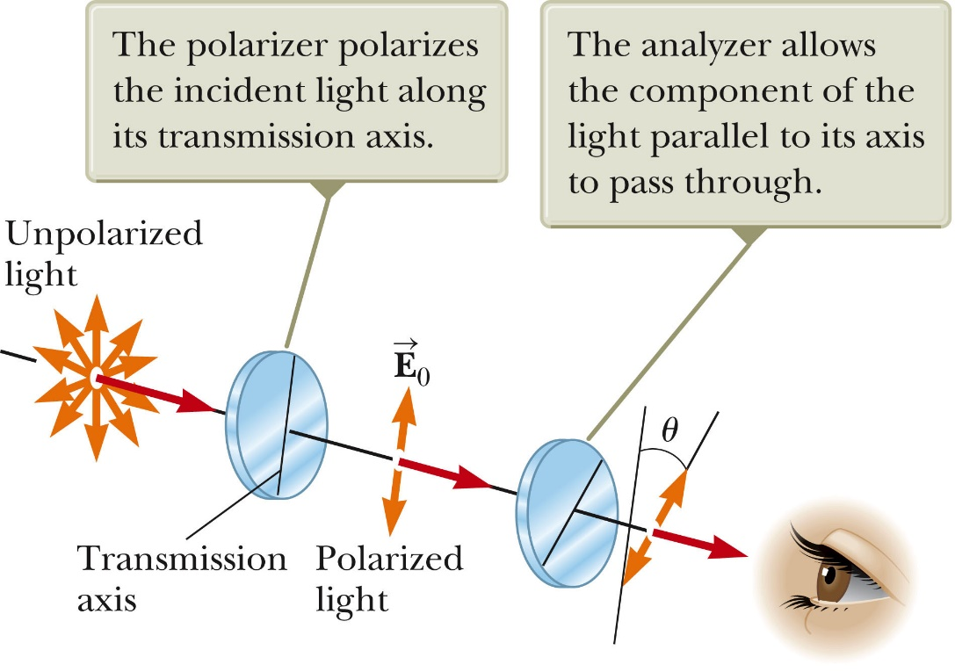
Unpolarized light, polarized light (polarizer), and analyzer
E-field transmitted by the analyzer:
$$\vec{E}=\vec{E_{0}}\cos{θ}$$
Light intensity transmitted by the analyzer: $\vec{I}=\vec{I_{0}}\cos^{2}{θ}$ (Malus’s law)

Slide 24
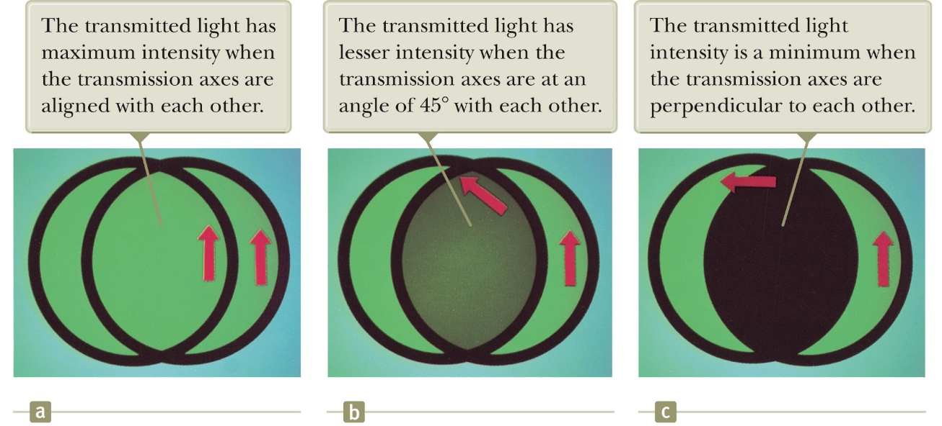
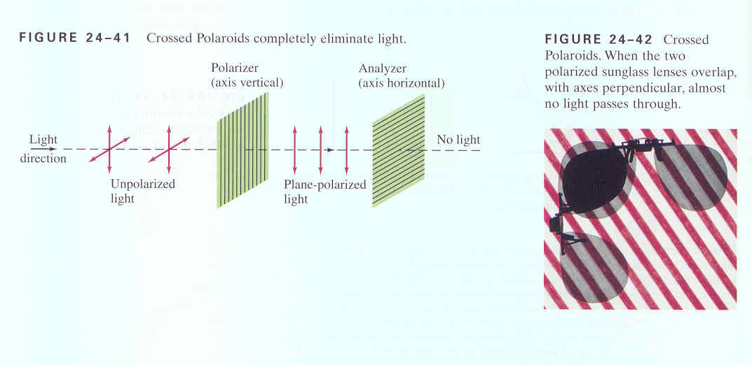
Polarization of light
(Demo: transmitted light by two polarizers)
Fig. 38-27, p. 1128

Slide 25
Four different ways to create polarized light
Polarization by Selective Absorption
Polarization by reflection
Polarization by double refraction
Polarization by scattering

Slide 26
Polarization by Selective Absorption
Some material (metalized long molecule chains (polaroid), only pass light in one direction and (absorb light in the other direction (aligned with long chain molecules).

Slide 27
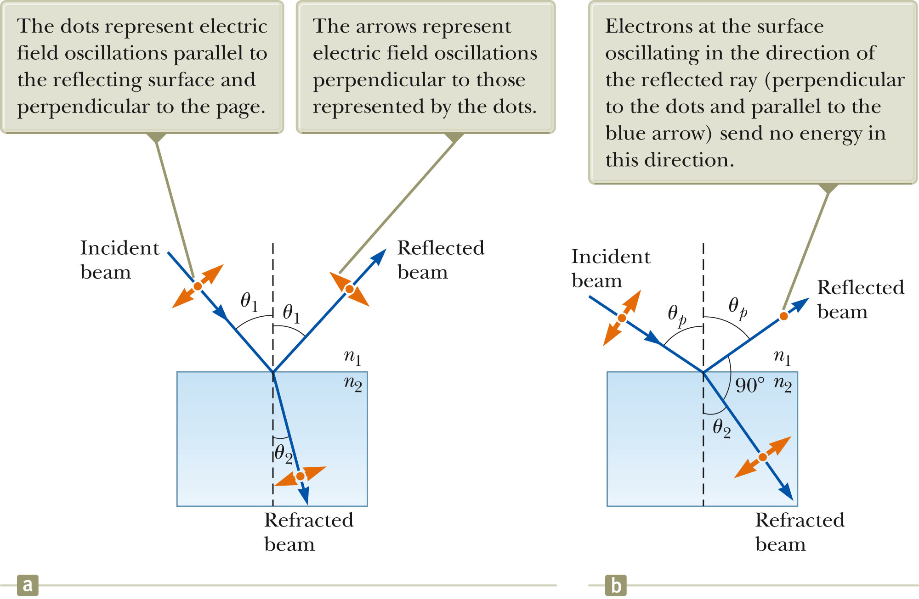
Polarization by reflection
Brewster’s angle:
$$tanθ_{P}=\frac{n_{2}}{n_{1}}$$
Get only polarized light reflected when looking at Brewster’s angle

Slide 28
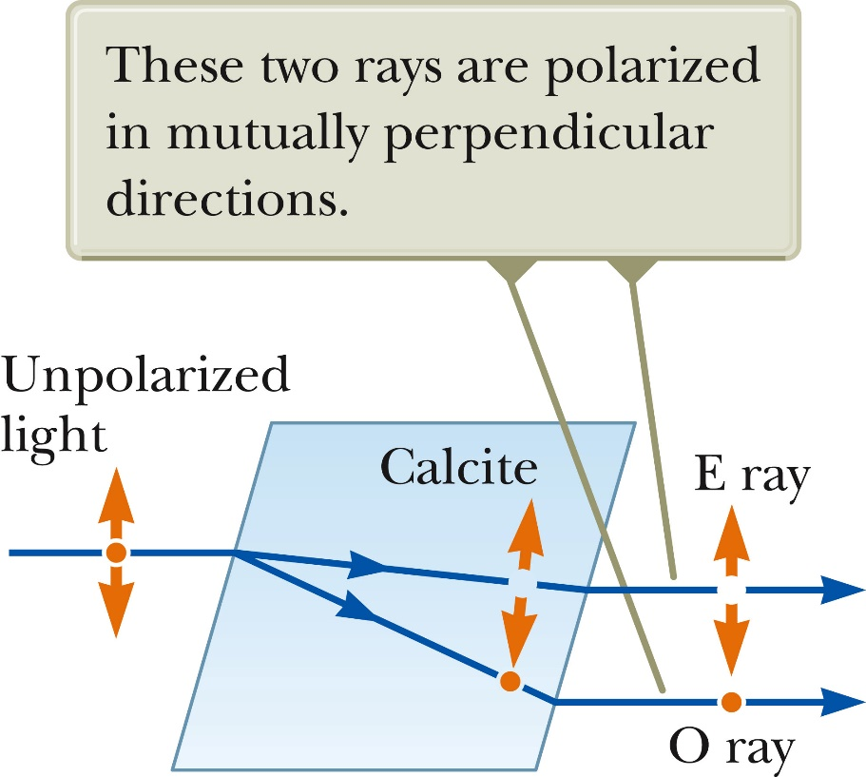
Polarization by double refraction
Some materials are double refracting (birefringent). Unpolarized light enters birefrigent light and gets and gets split up into an ordinary ray and extraordinary ray. These rays have mutually perpendicular polarizations

Slide 29
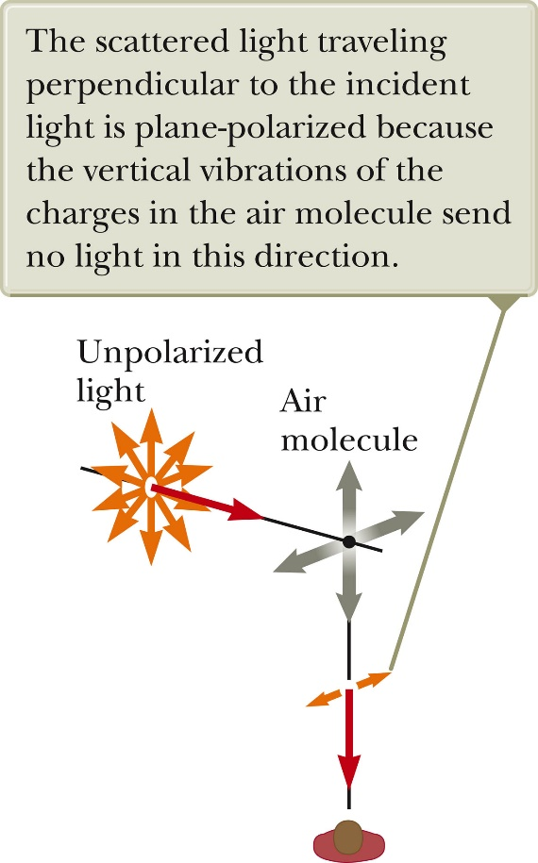
Polarization by scattering
When light is incident on any material, the electrons in the material can absorb and re-radiate part of the light. This light can be polarized. (dependent on electron configuration).

Slide 30
Review:
Light is treated as an (electromagnetic) wave
Huygens’ principle
Diffraction of light
Constructive and destructive interference of waves
Diffraction patterns of light at single slit, double slit, gratings
Thin film interference
Polarization of light

